Slide 1

Entity Framework Core
Course Introduction
SoftUni Team
Technical Trainers
Software University
https://about.softuni.bg/

Slide 2
Table of Contents
Course Objectives
Training and Team
Course Organization
Course Infrastructure
Evaluation Criteria
2

Slide 3
Have a Question?
sli.do
#csharp-db

Slide 4













SoftUni Diamond Partners

Slide 5

Course Objectives

Slide 6
Course Objectives
ADO.NET Library
ORM Fundamentals
Code-First and Database-First
Automapper Library
Advanced LINQ
JSON and XML
Best Practices and Architecture
ASP.NET Core
6

Slide 7
Practical Programming Exam
3 practical problems for 4 hours
Model Definition
Data Import
Data Export
Automated judge system
http://judge.softuni.bg
Solutions are evaluated for correctness only
Code quality is still not measured
7

Slide 8
Theoretical Exam
You will have 30 minutes once you enter
English
Automated quiz system
Available online the same day as the practical exam
You can submit your answers just one time
8

Slide 9

The Team

Slide 10
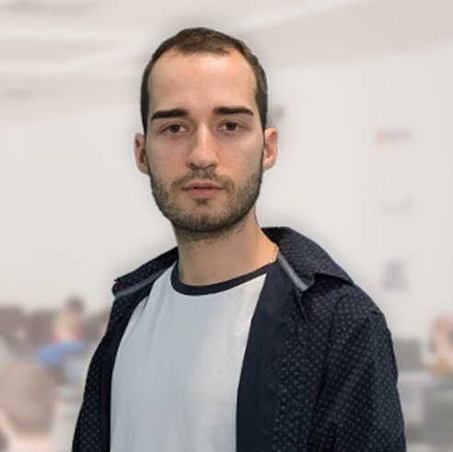
Nikolay Kostov
Solutions Architect @ ZenCodeo
15+ years in the IT
Developer, Manager, Trainer, Architect
Аctive role in the development of the Judge platform - https://judge.softuni.bg/
Microsoft Certified Trainer
Personal blog: nikolay.it

Slide 11
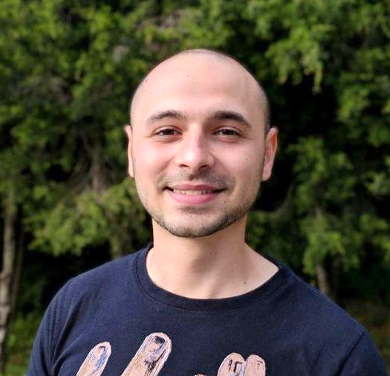
Stoyan Shopov
.NET Software Engineer
CoBuilder – Digitalization of Construction Industry
Technical Trainer @ SoftUni
3 years experience

Slide 12

Course Organization

Slide 13
C# Database Fundamentals Module – Timeline
15-Feb-2021
04-Apr-2021
Entity Framework Core
7 weeks * 4 times / week
15 credits
Start: 15-Feb-2021
Final exam: 04-Apr-2021
Retake exam: 11-Apr-2021

Slide 14

Homework Assignments & Exercises
Your homework is mainly work in class
Lesson days → slides + live demos + exercises
Exercise days → only exercises
How to submit your homework?
Submitted in the judge system
Do your homework when it's due
Assignments pile up quickly

Slide 15


Scoring System for the Course
Theoretical Exam 100%
PracticalExam 100%
Evaluation
Homework 5 %
15

Slide 16



Course Web Site, Forum and FB Group
Official web site:
Official discussion forum:
Official Facebook group:
https://softuni.bg/trainings/3221/entity-framework-core-february-2021
https://softuni.bg/forum/categories/63/module-csharp-db
https://www.facebook.com/groups/csharpdbjanuary2021

Slide 17
Questions?
Notes:
17

Slide 18
Trainings @ Software University (SoftUni)
Software University – High-Quality Education, Profession and Job for Software Developers
softuni.bg, about.softuni.bg
Software University Foundation
softuni.foundation
Software University @ Facebook
facebook.com/SoftwareUniversity
Software University Forums
forum.softuni.bg
18
Notes:
18

Slide 19

License
This course (slides, examples, demos, exercises, homework, documents, videos and other assets) is copyrighted content
Unauthorized copy, reproduction or use is illegal
© SoftUni – https://about.softuni.bg
© Software University – https://softuni.bg
Notes:
19

